Slide 1
Contents
Glossary or Formula Page
Page
Date
Description
2
3

Slide 2
Tasks
24
7
30
Essential Question
Questions
Notes
Summary
4
5

Slide 3
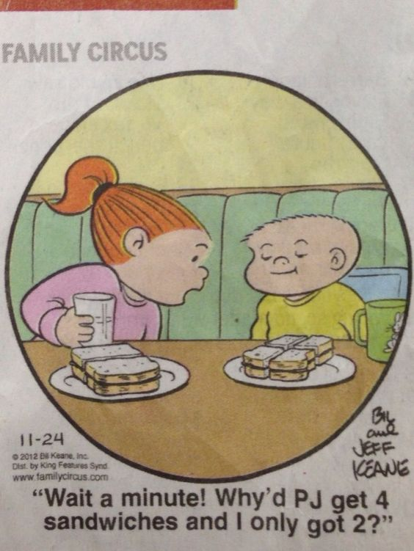

Slide 4
New Topic
MEASUREMENT

Slide 5
24
7
30
20 Feb 18
Units of length
EQ – How do I covert between metric units of length?
5

Slide 6
How Big?
In pairs, estimate the following measurements:
How long is an AFL oval? 185m
How long is a cricket pitch? 20.12m
How long is a netball court? 30.5m
How far is it from Perth City to Baldivis? 46km

Slide 7
24
7
30
Date
Units of length
EQ – How do I covert between metric units of length?
What are units of measurement ?
mm
cm
m
km
millimetres
centimetres
metres
kilometres
5

Slide 8
24
7
30
Date
Units of length
EQ – How do I covert between metric units of length?
Converting Units
Converting Units
How do I convert units?
km m cm mm
5

Slide 9
24
7
30
Date
Units of length
EQ – How do I covert between metric units of length?
Converting Units
Converting Units
How do I convert units?
x1000
km m cm mm
5

Slide 10
24
7
30
Date
Units of length
EQ – How do I covert between metric units of length?
Converting Units
Converting Units
How do I convert units?
x1000 x 100
km m cm mm
5

Slide 11
24
7
30
Date
Units of length
EQ – How do I covert between metric units of length?
Converting Units
Converting Units
How do I convert units?
x1000 x 100 x10
km m cm mm
5

Slide 12
24
7
30
Date
Units of length
EQ – How do I covert between metric units of length?
Converting Units
Converting Units
How do I convert units?
x1000 x 100 x10
km m cm mm
Questions:
45cm = _________ mm
5.6m = _________ cm
1.65km = _________ m
2.67m = _________ mm
5

Slide 13
24
7
30
Date
Units of length
EQ – How do I covert between metric units of length?
Converting Units
Converting Units
How do I convert units?
x1000 x 100 x10
km m cm mm
Questions:
45cm = _________ mm
5.6m = _________ cm
1.65km = _________ m
2.67m = _________ mm
450 x10
560 x100
1650 x1000
2670 x100 x10
5

Slide 14

24
7
30
Date
Units of length
EQ – How do I covert between metric units of length?
Converting Units
Converting Units
How do I convert units?
x1000 x 100 x10
km m cm mm
$÷$10
5

Slide 15

24
7
30
Date
Units of length
EQ – How do I covert between metric units of length?
Converting Units
Converting Units
How do I convert units?
x1000 x 100 x10
km m cm mm
$÷$100 $÷$10
5

Slide 16

24
7
30
Date
Units of length
EQ – How do I covert between metric units of length?
Converting Units
Converting Units
How do I convert units?
x1000 x 100 x10
km m cm mm
$÷$1000 $÷$100 $÷$10
5

Slide 17
24
7
30
Date
Units of length
EQ – How do I covert between metric units of length?
Converting Units
Converting Units
How do I convert units?
x1000 x 100 x10
km m cm mm
$÷$1000 $÷$100 $÷$10
Change the following to the given units
245cm = _________ m
780mm = _________ cm
2.464km = _________ cm
5

Slide 18
24
7
30
Date
Units of length
EQ – How do I covert between metric units of length?
Converting Units
Converting Units
How do I convert units?
x1000 x 100 x10
km m cm mm
$÷$1000 $÷$100 $÷$10
Change the following to the given units
245cm = _________ m
780mm = _________ cm
2464cm = _________ km
2.45 ÷100
78 ÷10
0.02464 ÷100 ÷1000
5

Slide 19
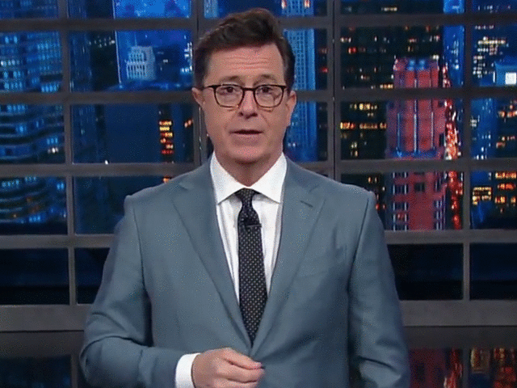

Practice
x1000 x 100 x10
km m cm mm
km m cm mm
Convert:
6 km = _________ m
500 m = _________ km
6 m = _________ cm
7.5 cm = _________ mm
7000 mm = _________ m
12 km = _________ cm
$÷$1000 $÷$100 $÷$10

